Slide 1
Common-Mode: Roach Comparison
Jonah Lee

Slide 2
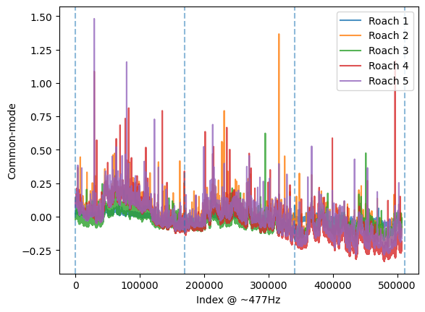
Time Domain
Vertical lines segment time into the three passes.
The end of the third pass is excluded because the calibration lamp was turned on before the pass completed.

Slide 3
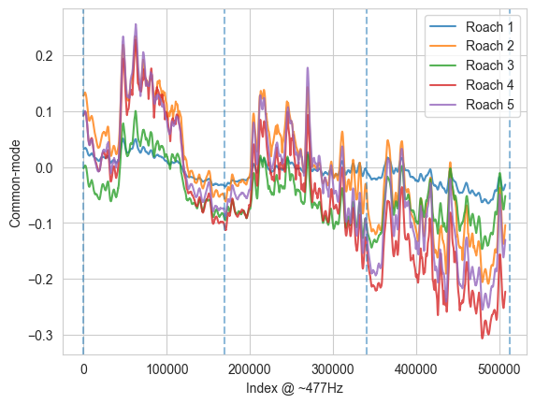
Time Domain
With Savitzky-Golay filter.
Window = 2000
Poly. Deg. = 1

Slide 4
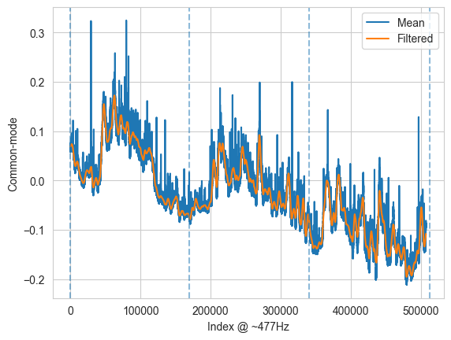
Mean

Slide 5
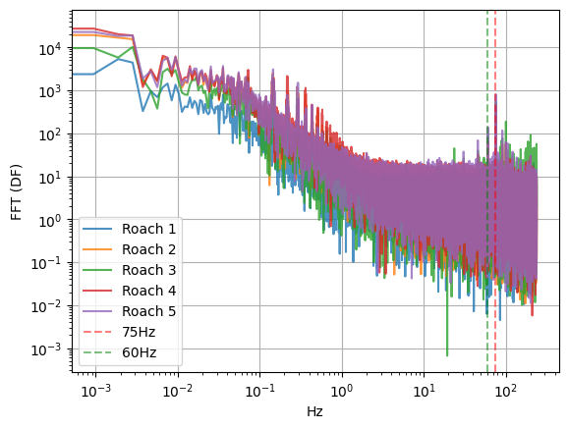
Frequency Domain

Slide 6
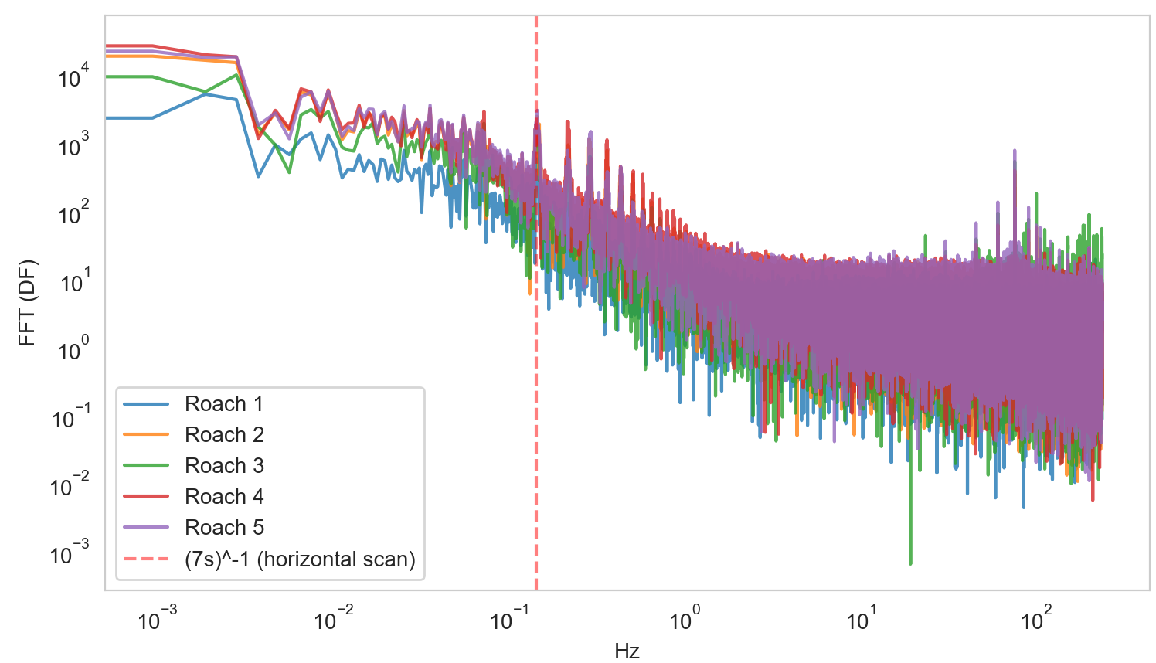

Slide 7
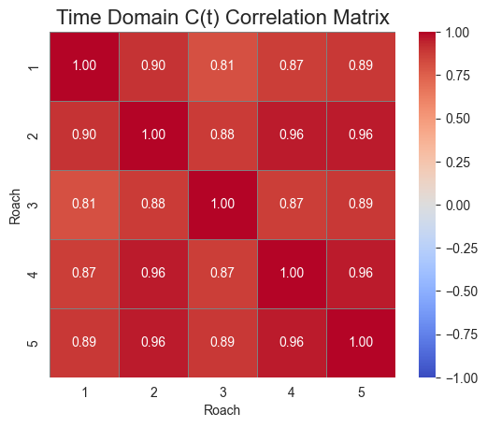
Correlation Matrix - Time Domain
Roach 2, 4 and 5 share a strong correlation in the time domain, which is expected as they are all at 250um.
Roach 1/3 diverge from this slightly, and have even less correlation with each other. See slide 3 for trends.

Slide 8
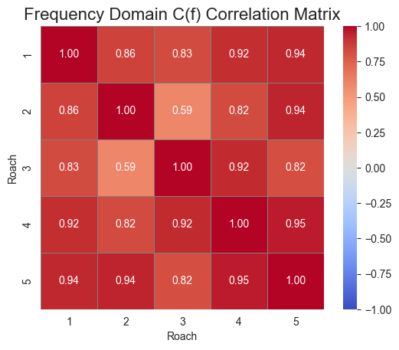
Correlation Matrix - Frequency Domain
In the frequency domain, the correlation between 250um roaches is weaker.
Roach 5 has strong correlation with all but roach 3.
Roach 2 and 3 have relatively different PSDs.

Slide 9
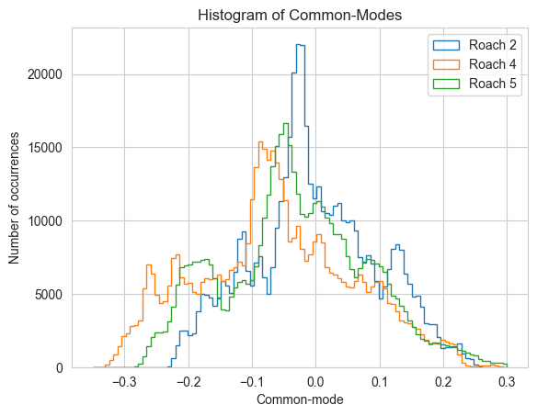
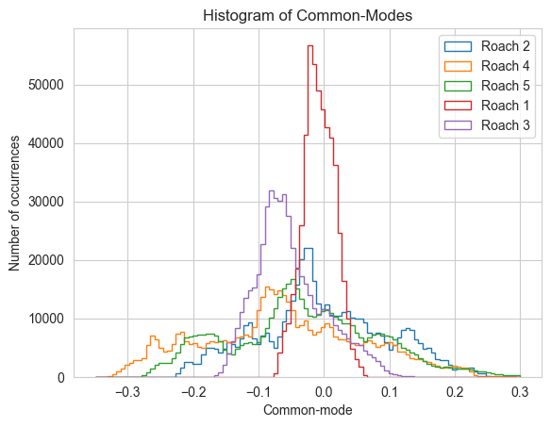
Histogram

Slide 10
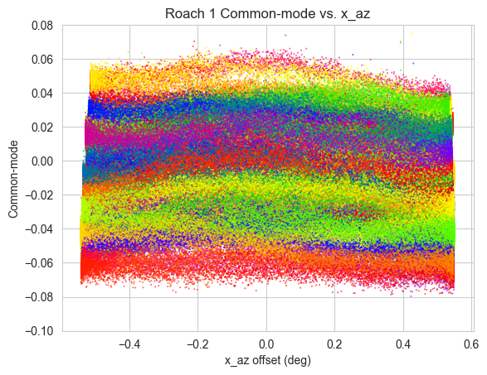
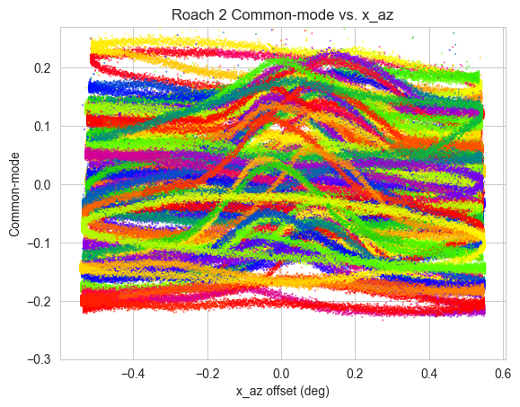
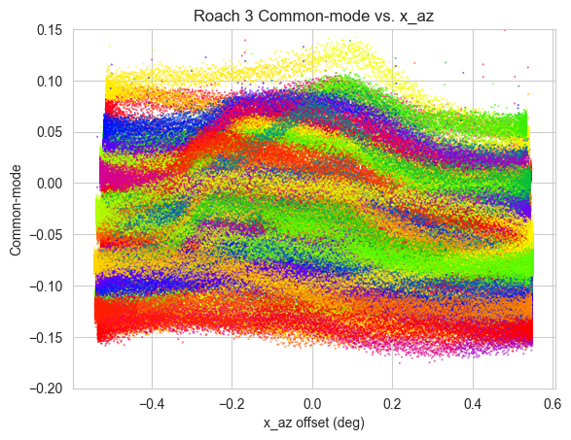
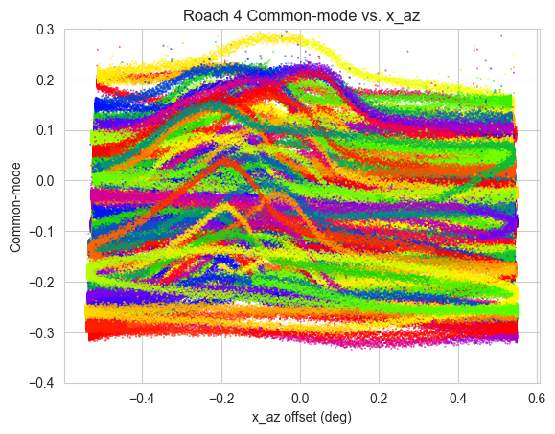
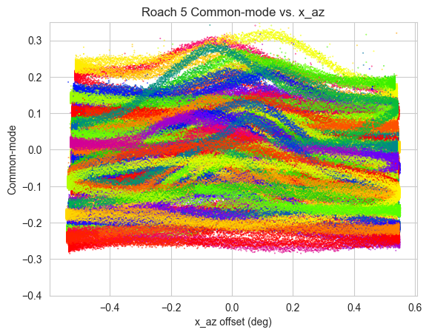
C(t) vs. x Position - Source Influence
If the on-sky positions of KIDs are close enough together, when the telescope scans past the source it will activate almost all KIDs, causing a spike in c(t).
Q: Why do 250um (roach 2/4/5) look different?

Slide 11
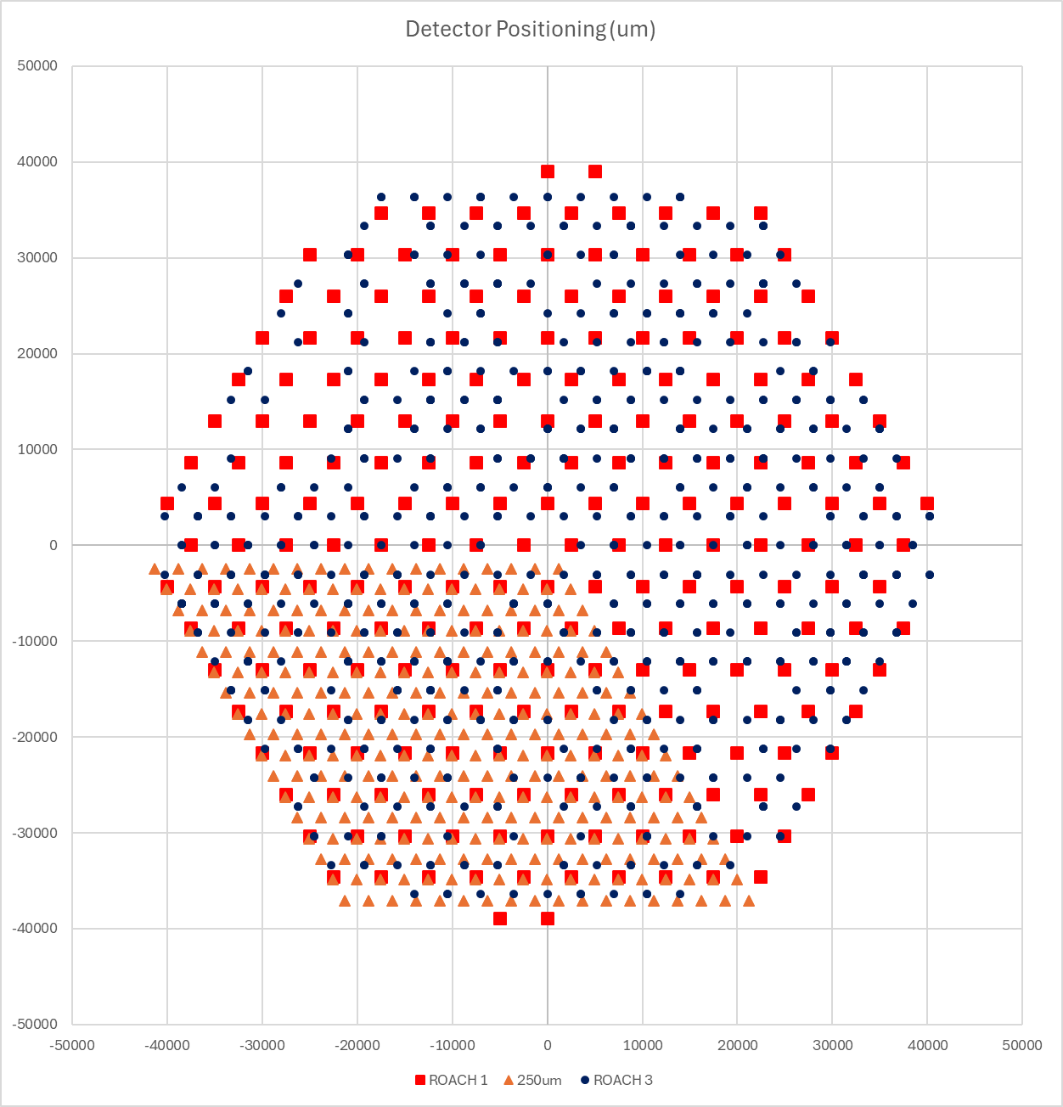
Hypothesis: Different On-Sky “Grid” Sizes
The 250um arrays are split into 3 (see right). The smaller arrays mean the scan will sometimes miss the source fully, and when the source is detected it will impact a higher proportion of KIDs.

Slide 12
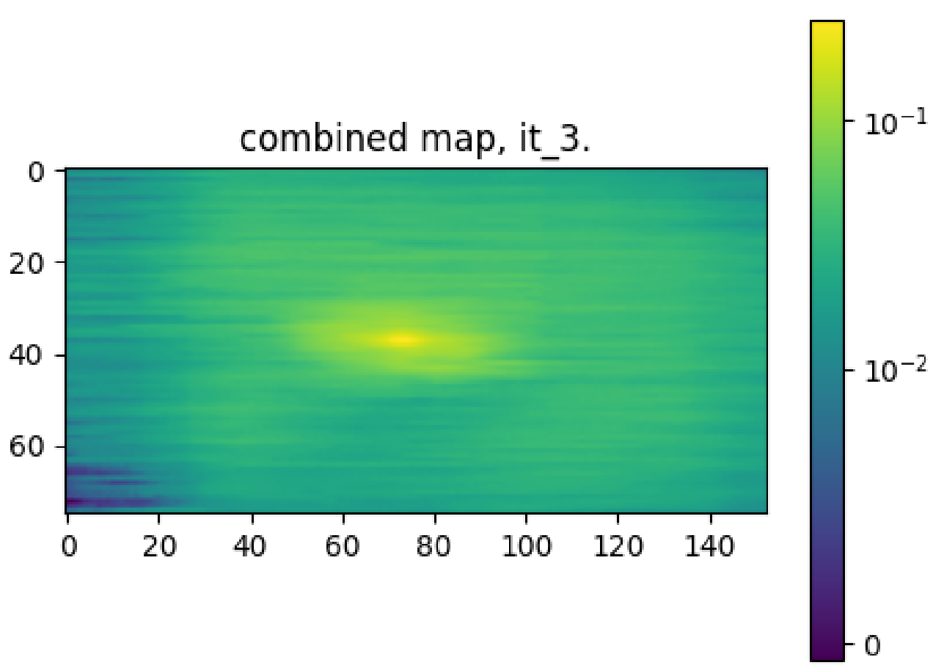
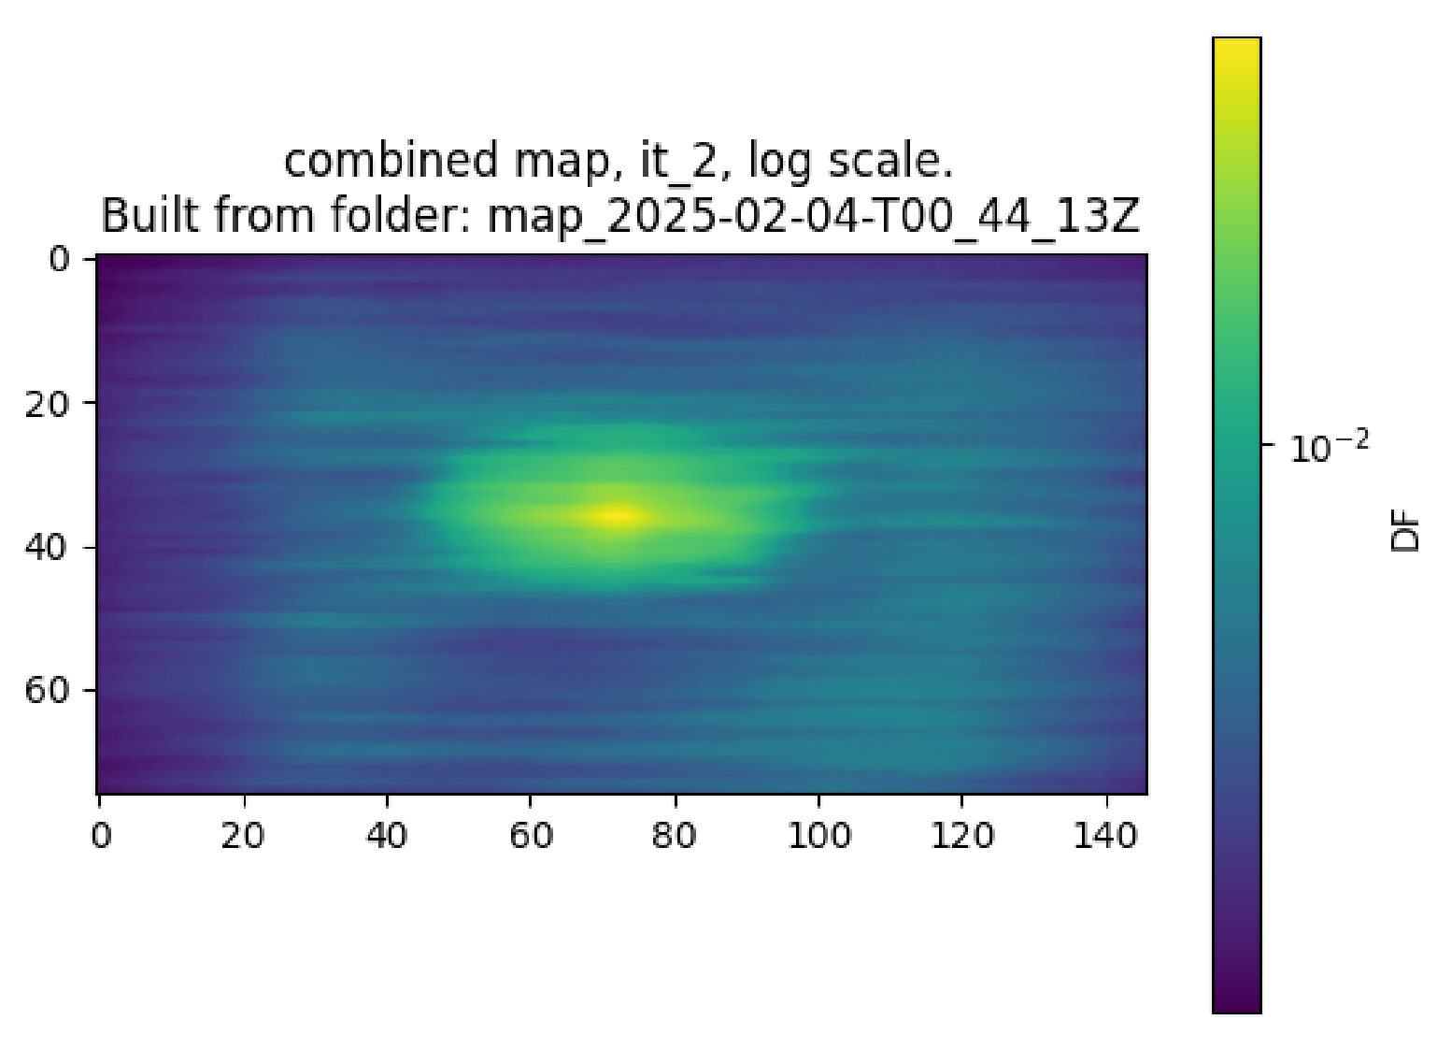
Possible Solution: Combine C(t) for Roach 2, 4, 5
If the problem is that the single arrays are too small, we should take the common-mode as a combination of all arrays.
This may not solve the problem entirely, but will be just as good as roach 1 and 3 wrt. grid size.
After (combined c(t))
Before (separate c(t))

Slide 13
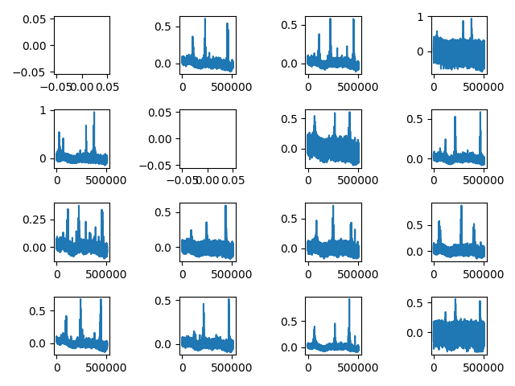
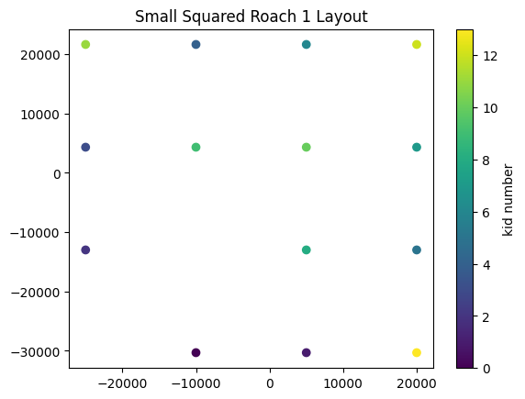
Roach 1 sample grid (wrong orientation!)

